Slide 1
SMG –“Patch” File Installation

Slide 2
Overview
Objective:
The BITE app gives your consumers access to nutritional information for all the services you offer.
We have provided a “patch” file in order to add these items to your SMG program so you can export a Signature Brand menu to BITE.
This document outlines the 6 easy steps to take for your menu to display in BITE

Slide 3
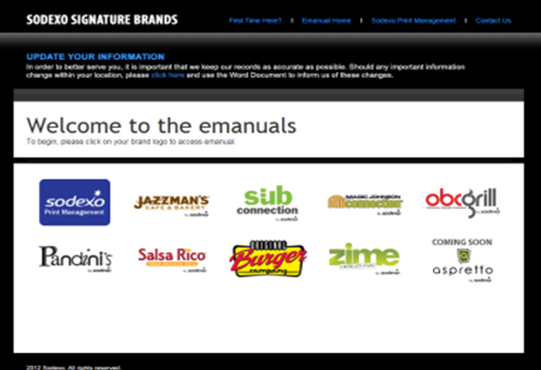
“Patch” File Installation
Files are available on the brand eManuals site. Go to:
https://www.retailbrandgroup.com/public/general/index.html
Each Brand has its own “patch” file
Right-click > Save As > SMG/DATATBLS
** Users will only see the brands they operate.

Slide 4
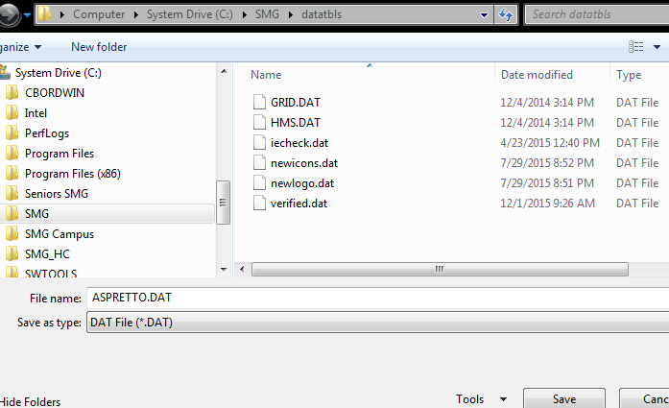
Step 1: “Patch” File Installation
Click > Save As > SMG/DATATBLS

Slide 5
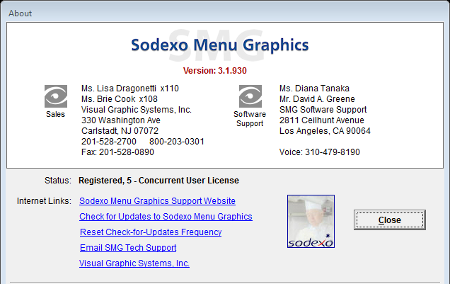
Step 2: “Patch” File Installation
Run SMG update (even if you just ran an update)

Slide 6
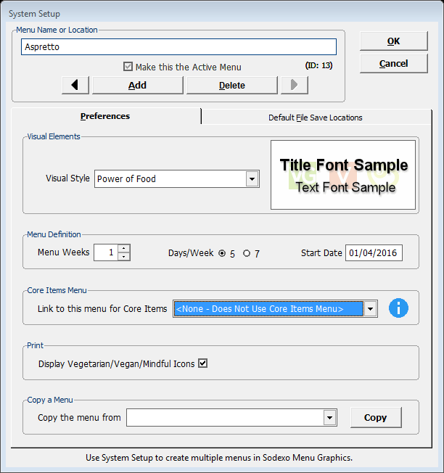
Step 3: “Patch” File Installation
Build a new menu
System Setup
Click Add
[Click OK on the dialogue box
that pops up]
Name your menu
Set Menu Weeks to 1 (it will keep repeating)
For the “Link to this menu for Core Item” option: choose None
Click OK
Your new blank menu is ready for building!
2
5
1
1
2
3
3
4
4
5

Slide 7
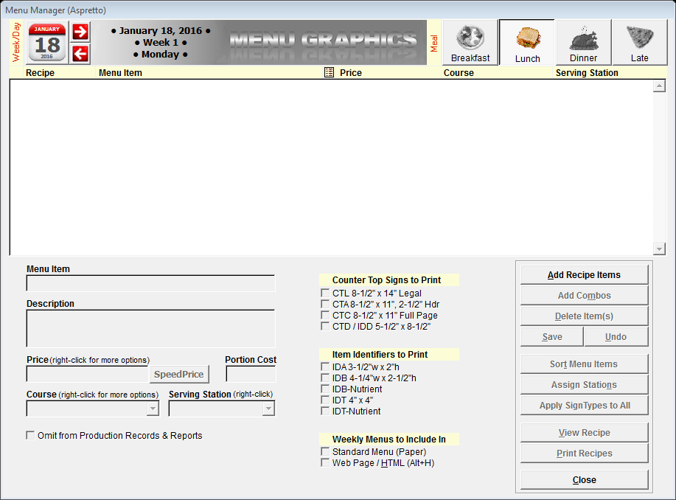
Step 4: Build Your Menu in SMG
Menu Manager
1. Add Recipe Items

Slide 8
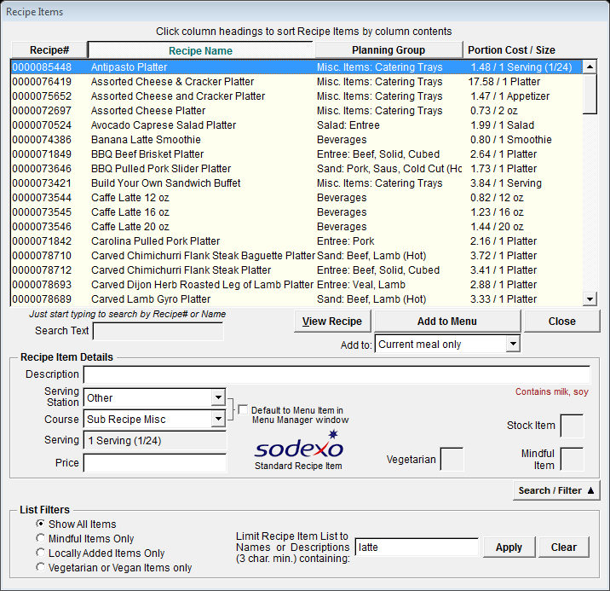
Step 4: Build Your Menu in SMG
1
2
You can add items by:
Recipe #
OR
Recipe Name
OR
Or Filter – if you are not sure of the exact name
1
2
3
3
3

Slide 9
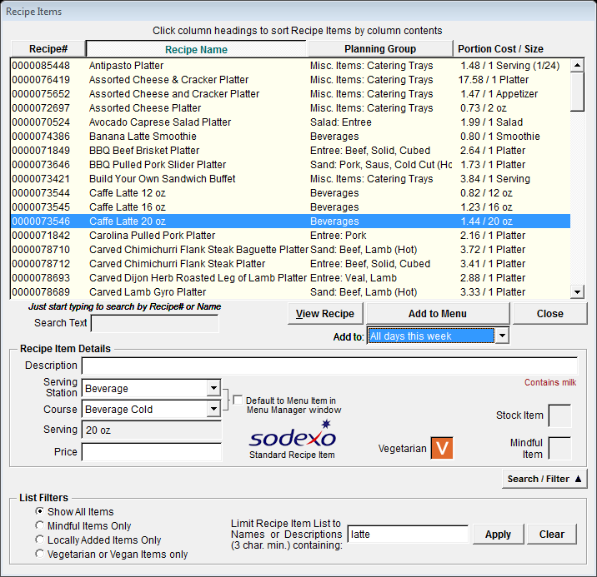
Step 4: Build Your Menu in SMG
Add to Menu
All days this week
1
2
1
2

Slide 10
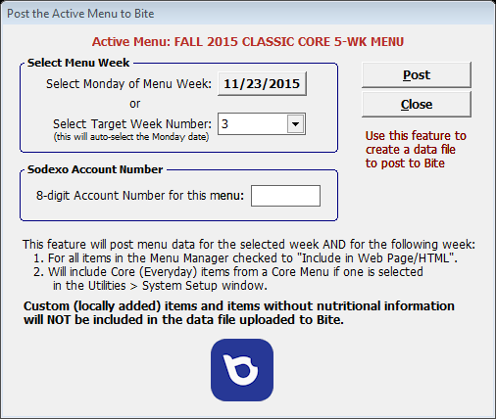
Step 5: Export Each Signature Brand Menu to Bite
2
Before you start, make sure the Brand Menu is the active menu.
<Utilities> <Post the Active Menu to Bite>
Choose the Week start Date or the Week number and meal periods
Enter your 8-digit Account Number
Click: <Post>
Remember you are creating up to 2 weeks of menus at a time to post, the current week and the next week.
2
3
5
4

Slide 11
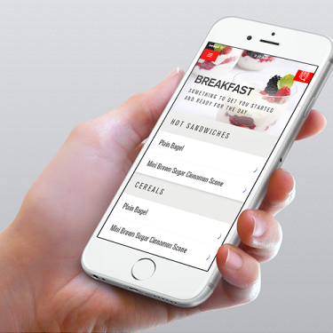
Step 6: Confirmation
Activate your menu in Retail Ranger
Go to BITE and confirm your menu can be viewed by your consumers.

Slide 12
Support
SMG
www.smgsupport.com Dave Greene 310-479 8190 (west coast)
Bite https://noram.sodexonet.com/sdxnet/usen/usa/resources/guidelinesandstandards/offerings/culinary_solutions/bite.aspx

